Slide 1
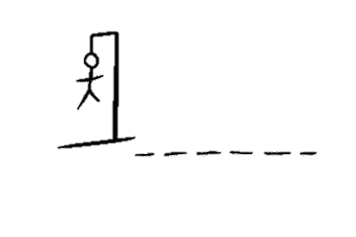
Hangman
P Y T H N
A classic hangman game with a scoreboard to track points and play with friends
Coded By: Carlos Alfaro and Lindsay Lauterbach
GitHub Repository: https://github.com/ksu-is/hangman-scoreboard

